Slide 1
Bemas Technologies Ltd
(Proposed System Overview)
CALL CENTER
For
ROCHE PHARMACEUTICAL

Slide 2
Hosted Call center Service
Robust hosted call center solution with all feature included. 30 concurrent calls or 30 agents can login. Ready in 48 hours. It costs N120,000.00 (and N20,000.00 per month)
Premised call center service
Windows and web based full featured call center application deployed at your office datacenter with GSM Gateway + mini-Server. 8 agents and concurrent calls. Ready in 14 days. It costs N890,000.00

Slide 3
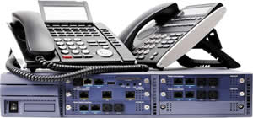
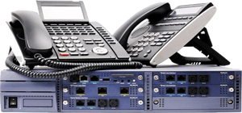
hosted ip-pbx service
Enterprise grade hosted PBX system with ALL PBX features included. 30 users and 30 concurrent calls, ready in 48 hours. It costs N120,000.00 (and N20,000.00 per month)
premised IP-pbx service
Full featured PBX box, mini-server + GSM gateway all deployed at your datacenter. 8 users and 8 concurrent calls. Ready in 14 days
It costs N890,000.00

Slide 4
CRM Plugin
This plugin works together with Call Center. It connects to most CRM application and pops up caller detail from CRM or database so the attending agents can better interact with caller.
It costs N120,000.00
CRM Application
Complete Customer Relationship Management application built to enhance business intelligence and customer retention.
Price: N220,000.00 (and N20,000.00 per month)

